Slide 1
Software Testing &
Approaches: 891 Project
Abdulrehman K, Afsah R, Hamza I, Fatima R

Slide 2
WHAT IS MINDUSTRY?

Slide 3
MINDUSTRY
Open source software written in Java
Sandbox, multiplayer tower-defense game
Able to build, defend, attack, and heal
100+ Classes, but <10 testing classes

Slide 4
Features Tested: Examples
Factory Building - #9: BuildWeapon.java
Health and Damage - #3: Health.Java
Tower Defence - #5: LiquidBlock.java

Slide 5
Testing Abstractions

Slide 6
Input Space Partitioning

Slide 7
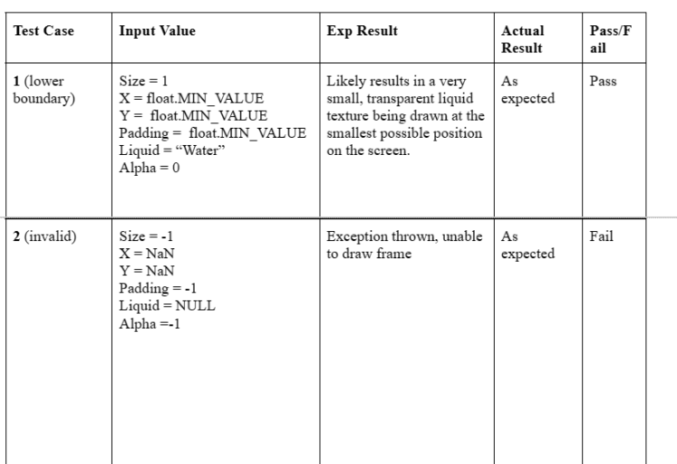
ISP - Feature #5: LiquidBlock.java - BVA

Slide 8
ISP - Feature #3: Health.java
Test Cases
Player HP bar with negative, zero, positive, and >100 val
Example Input: Health = 0
Expected Output: Player is killed

Slide 9
Control Flow
Graph

Slide 10
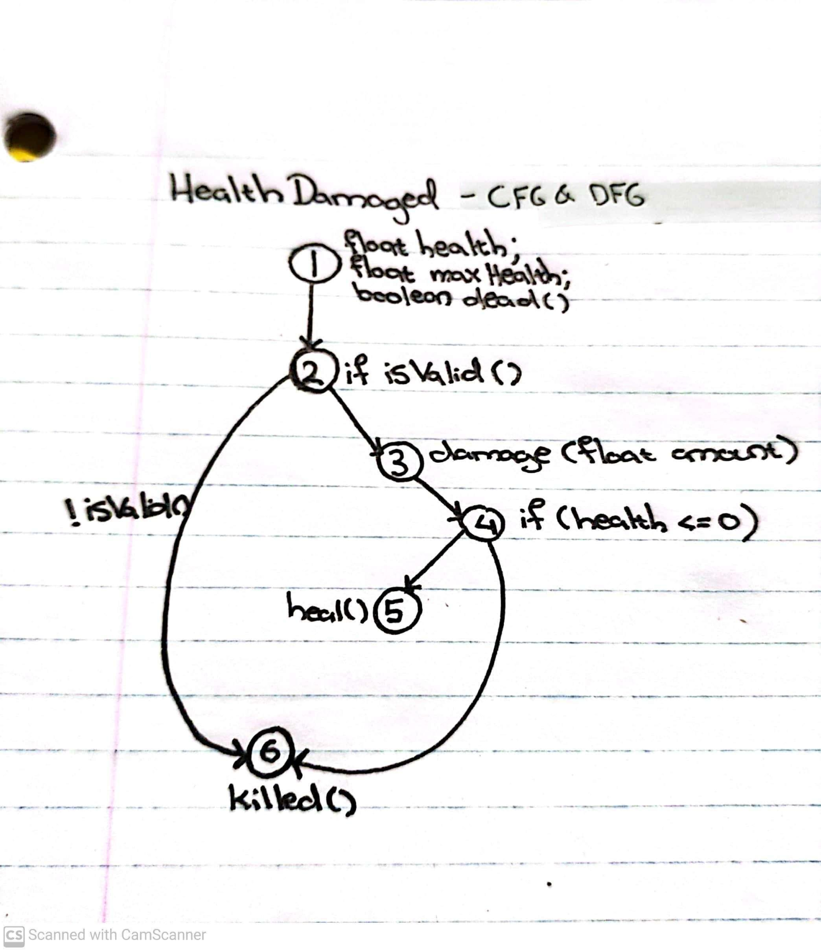
CFG - Feature #3: Health.java
The progress of a player’s health as they receive damage.
Check if the player health is 0 - they are killed
Otherwise, continue receiving damage
If health is less than 0 after damage, player is killed
Otherwise, they heal

Slide 11
Data Flow Graph

Slide 12
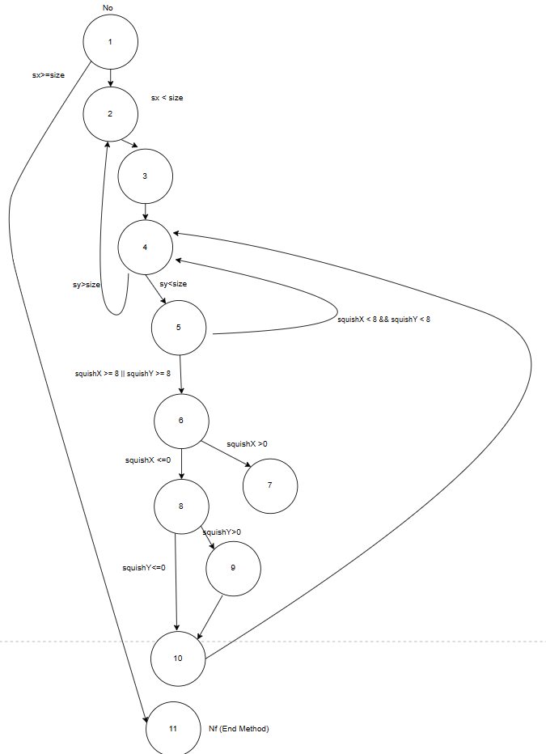
DFG - Feature #5: LiquidBlock.java
The drawTiledFrames method is in charge of rendering the liquid block on the game screen by creating tiled frames. it ensures that the liquid flows and animates smoothly on the screen
After specifying the position and specifications for the drawn frame, it goes on to loop through the frames and draw each one on the screen.
drawTiledFrames method of LiquidBlock.java

Slide 13
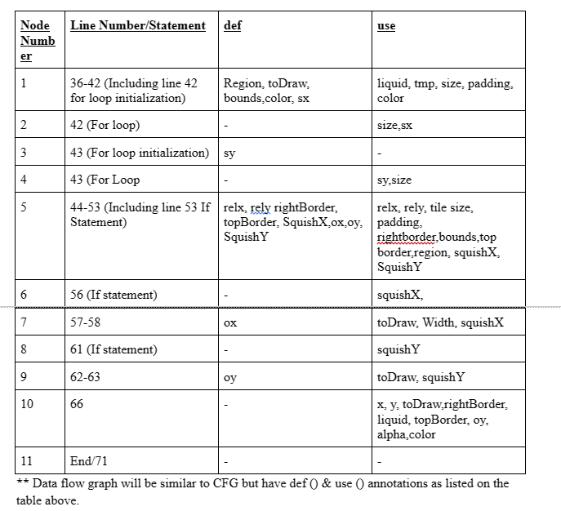
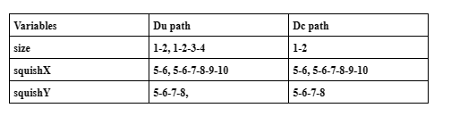

Slide 14
Logic Based Testing

Slide 15
LBT - Feature #3: Health.java
Reachability Predicates:
isvalid(), update(), killed(), damaged(), heal()
Predicate Coverage - isValid()
Evaluate predicate !dead && isAdded() to both true and false
Clause Coverage - isValid()
Evaluate each clause, !dead and isAdded(), to both true and false

Slide 16
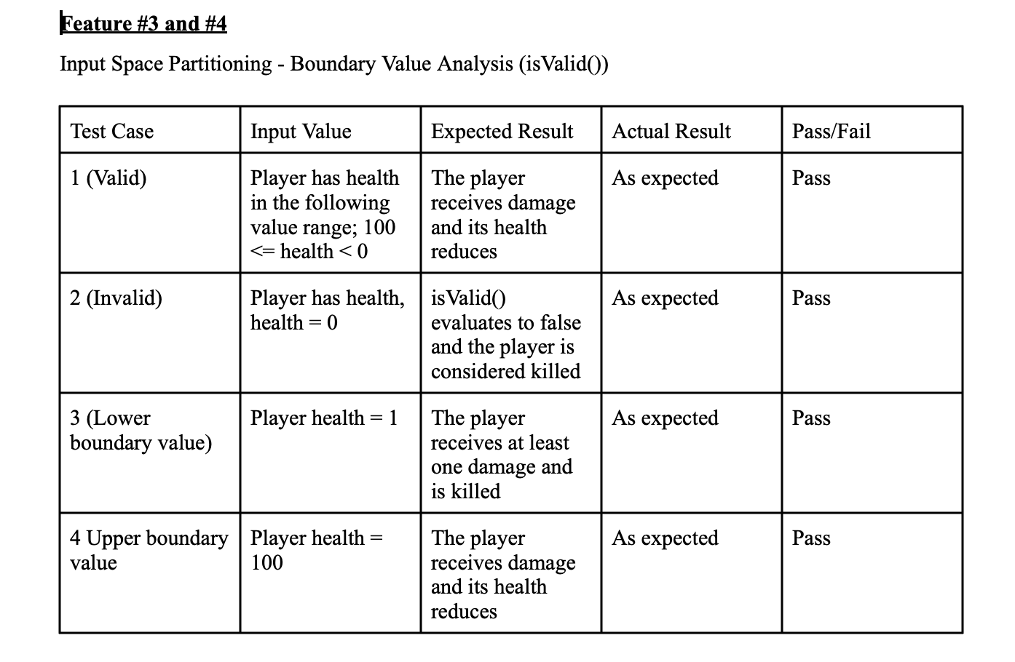
LBT - Feature #3: Health.java

Slide 17
FAULT TYPES

Slide 18
Faults
Minor performance faults
In some instances, the software appeared to be laggy. The lag is particularly pronounced in multiplayer games with more than 3 people.
When the map gets crowded with designs, players, enemies, and bullets, there appears to be some lag
Enemy “confused” behavior on certain maps
Incorrect Documentation and Lack of Existing Test
As the game is being built and updated on a near daily basis, the documentation is out of date in some places
Minimal prior testing has been done by contributors

Slide 19
COVERAGE

Slide 20
Coverage
The project has minimal testing or testing docs
100+ classes make it difficult to achieve 100% coverage
Were able to improve coverage in Mindustry.entities.Health, Mindustry.entities.Bullet, and various Mindustry.type and Mindustry.world classes according to the testing requirements defined in project plan

Slide 21
CHANGES & IMPROVEMENTS

Slide 22
Challenges
Logic-based testing
Difficulty in identifying all possible logical interactions between different parts of the code, especially in a game with a large and complex codebase.
Boundary value testing
Difficulty with boundary value testing in the Mindustry game was determining the appropriate boundaries for various input parameters. Additionally, difficulty in identifying all the boundary conditions that need to be tested, as there may be many edge cases and exceptions that are not immediately apparent.
Issue with testing on Eclipse
Could not compile on eclipse, used Intellij instead on Afsah’s computer

Slide 23
Reflection
Did not deviate from the test plan proposal
Stayed consistent with the methods and approaches for each class (8 in total), 4 methods each
Used JUNIT to create test cases
Used Intellij to compile the testss and excutte

Slide 24
Thank you

